Slide 1

HPC at the Smithsonian
Introduction to Hydra

Slide 2
Overview
Why HPC?
SI Computing Cluster
Support
Cluster Architecture
Submitting Jobs
Best Practices
Tips

Slide 3
Why High Performance Computing (HPC)?

Slide 4
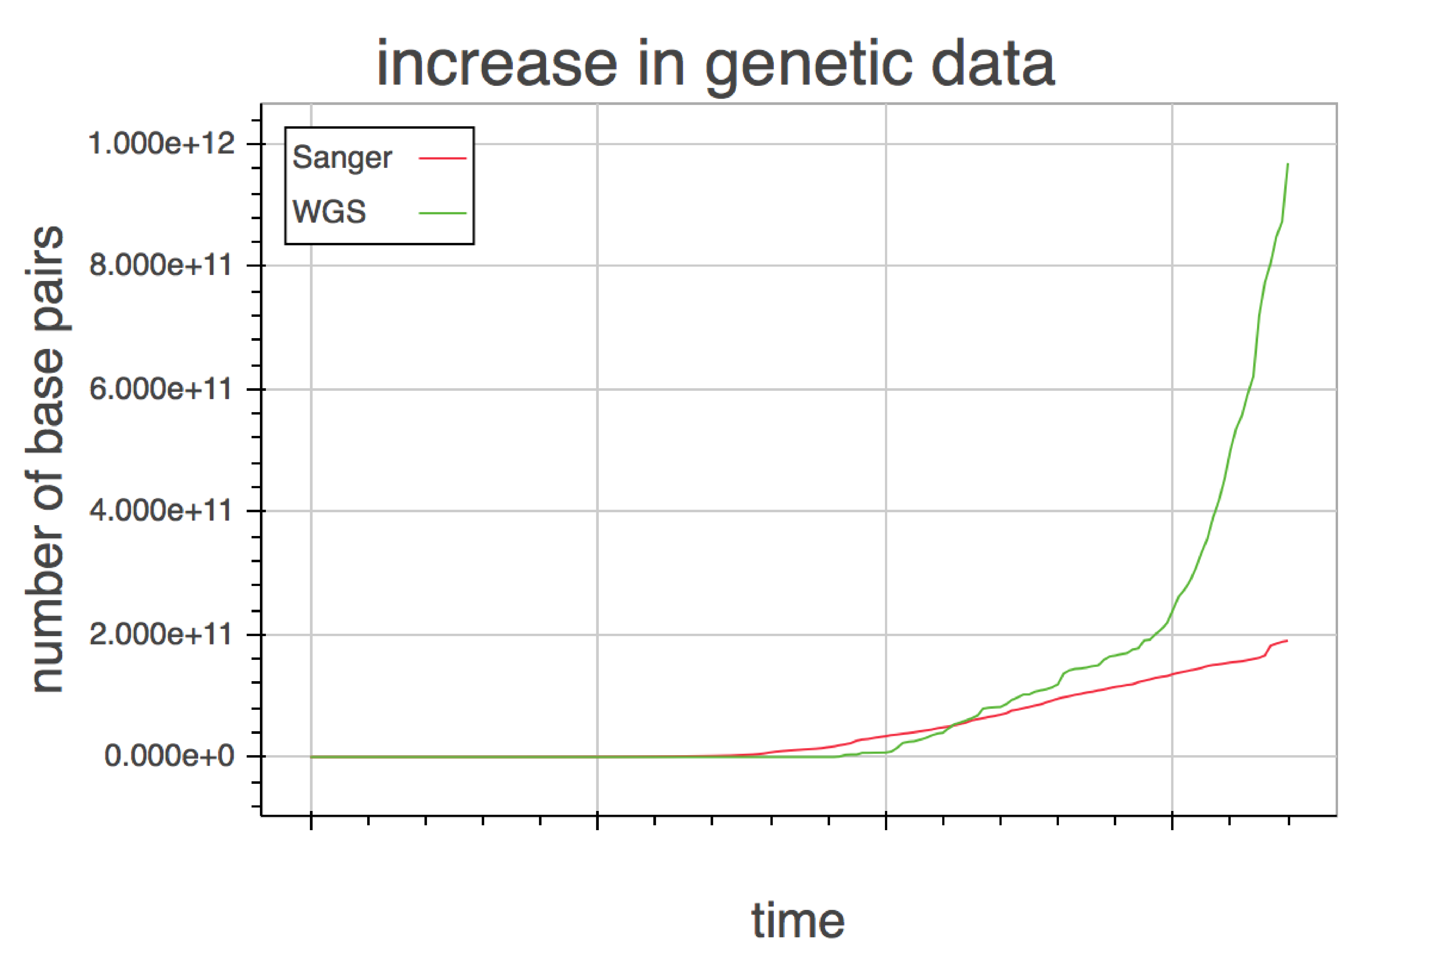
Why HPC?
🐞

Slide 5


Why HPC?
🐞
Size
&
Speed

Slide 6
Why HPC?
🐞
Size: some analyses use too much memory to be completed on a standard desktop/laptop, e.g. de novo genome assembly
Speed: all about parallel computing! A problem that might take months on a desktop can take hours on a HPC, e.g. BLAST searches

Slide 7
SI Computing Cluster

Slide 8
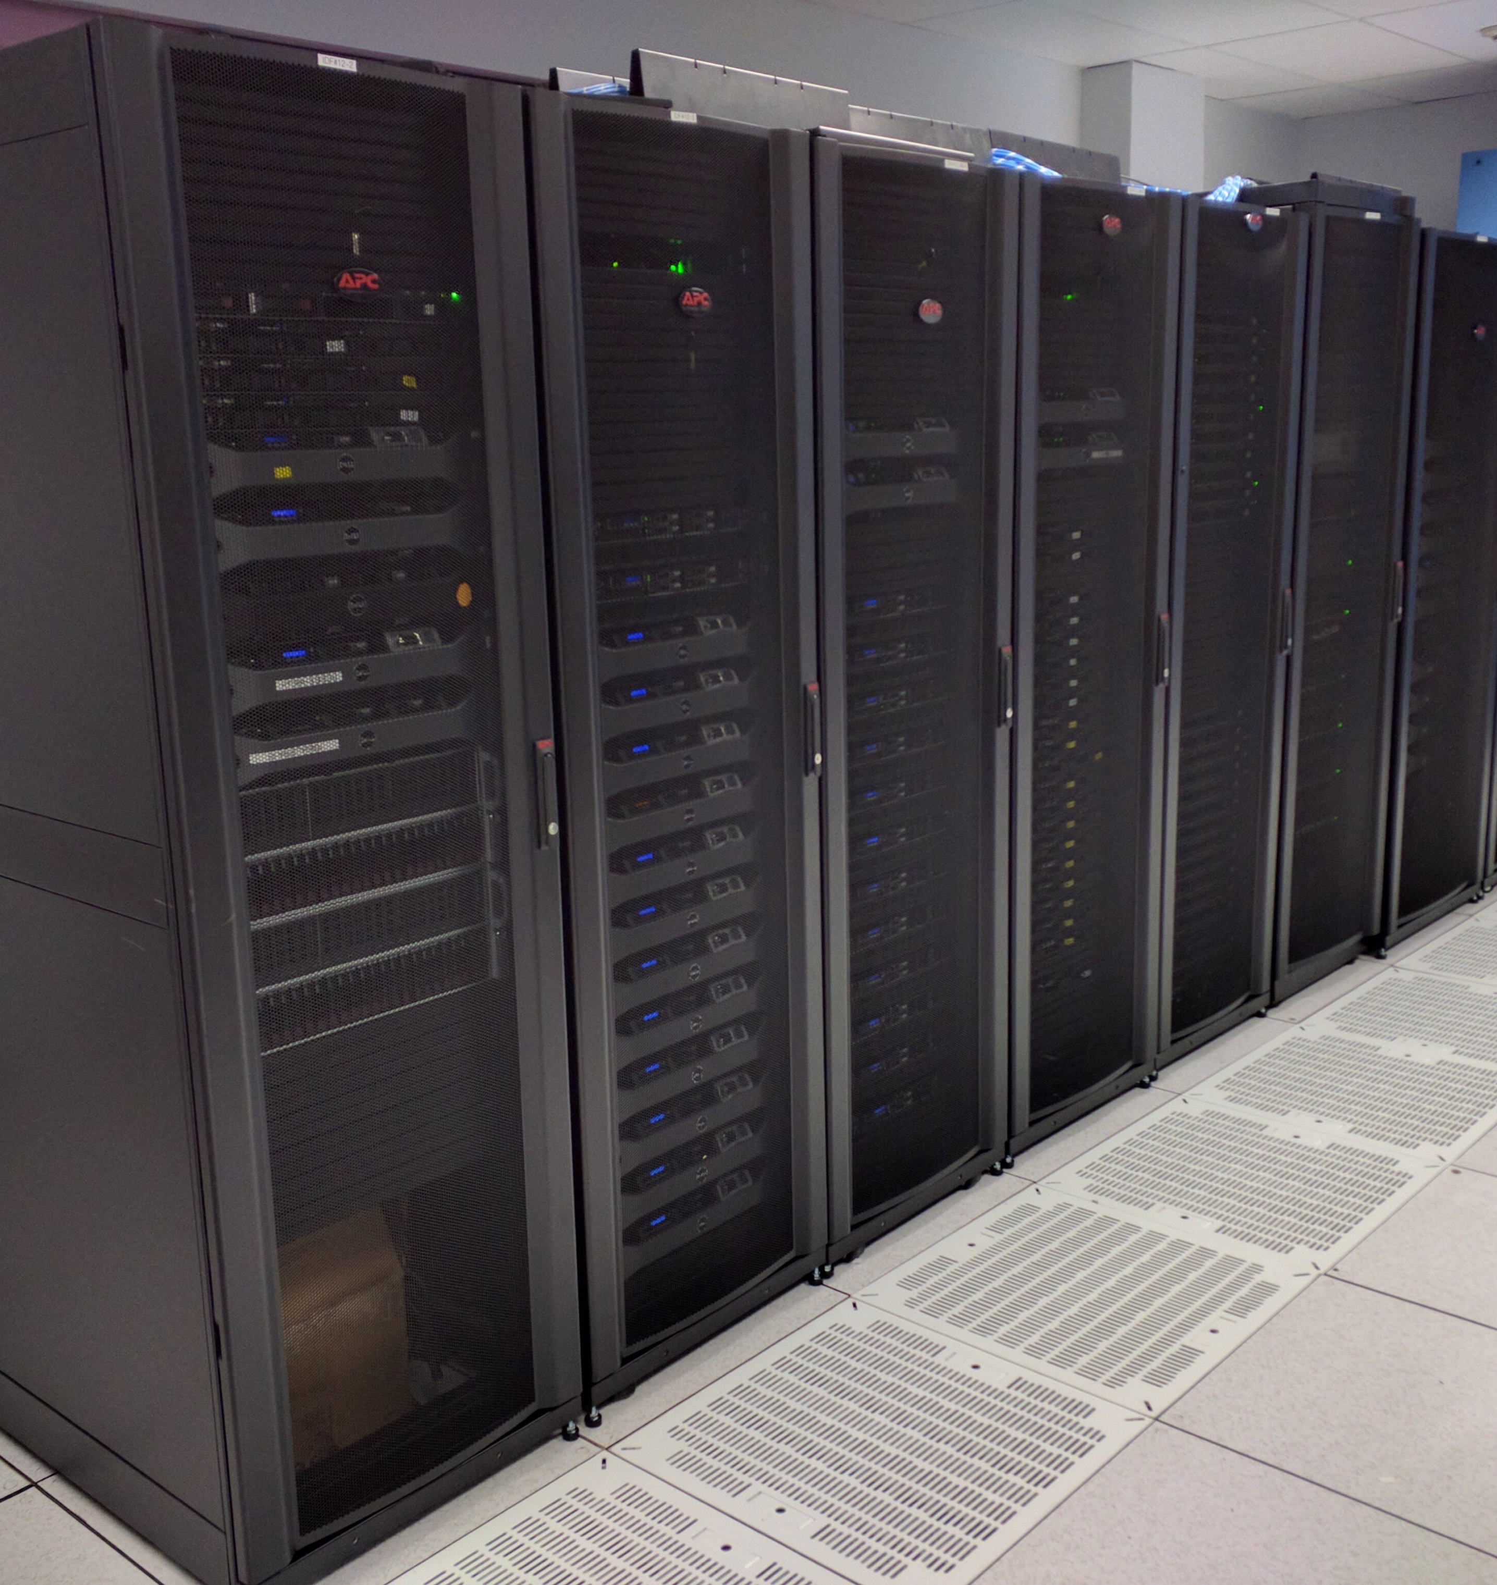
Hydra
🐥
Smithsonian HPC cluster
3,950 CPUs, 26 TB of RAM
16 high memory nodes (14 512GB; 2 1TB RAM; 1 2TB RAM)
Many high CPU nodes with 64 CPUs

Slide 9
Support

Slide 10
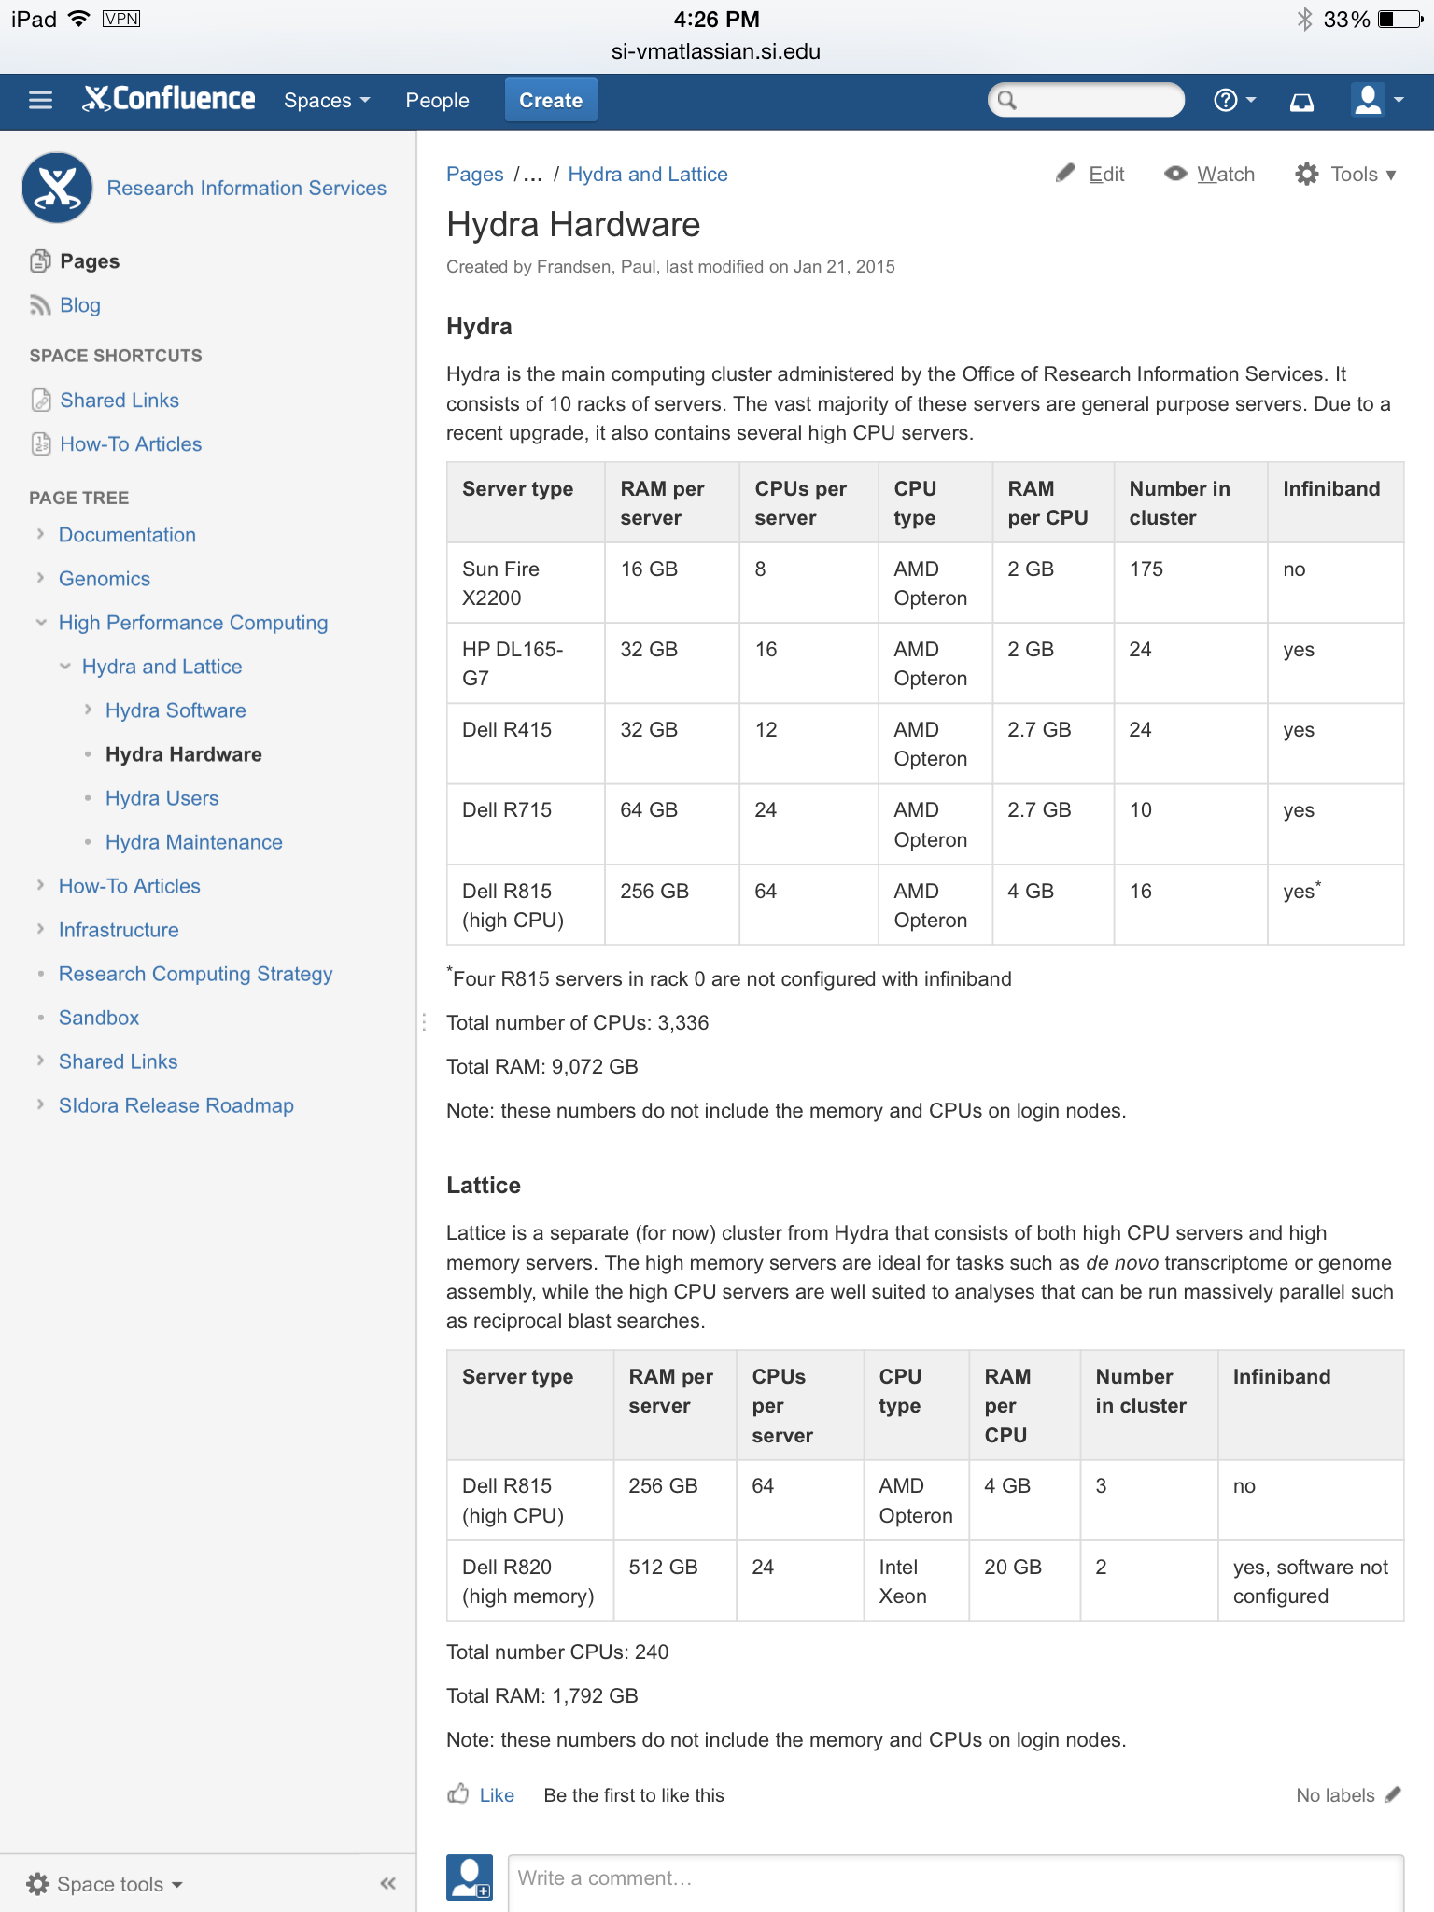
https://confluence.si.edu/HPC

Slide 11
Sysadmin support:
Jamal Uddin, OCIO
Sylvain Korzennik, SAO
SI-HPC-admin@si.edu
Rebecca Dikow, OCIO
Application support:
Rebecca Dikow, OCIO
Matt Kweskin, LAB
Vanessa González, GGI
SI-HPC@si.edu
Mirian Tsuchiya, OCIO
Mike Trizna, NMNH

Slide 12
Cluster Architecture

Slide 13
Cluster Architecture
Many computers connected to each other via an interconnection network (interconnect) with software that controls where jobs are run
Each computer in the cluster is called a node
Login nodes: users log into these to access the cluster and launch jobs, they perform no real computation (hydra-login01.si.edu, hydra-login02.si.edu)
Compute nodes: actually run your program
Head node: runs the software that controls the cluster and the jobs

Slide 14
Queuing System/Job Scheduler
Software that schedules the jobs and submits them to the compute nodes.
Hydra uses the “(Sun) Grid Engine” queuing system.
Most jobs should be run in batch mode. To submit jobs, you use the command "qsub"
There is also an interactive mode for short jobs. To initiate, type “qrsh”

Slide 15
Submitting Jobs

Slide 16
Job Submission:
You need to know…
Number of CPUs/type of parallel environment
Time you job will take
Memory you would like to reserve
Job specific information (module required, job specific commands)

Slide 17



Number of CPUs: Parallelization
Naive parallelization (embarrassingly parallel)- one large job easily split into separate jobs.
E.g. many sequential blast searches at once, splitting bootstrap reps.
CPU cores
RAM

Slide 18
Number of CPUs: Parallelization
Multi-threading (pthreads, OpenMP)-multiple CPUs on a single node. This method uses shared memory.

Slide 19
Number of CPUs: Parallelization
MPI (Message Passing Interface)-multiple CPUs across multiple nodes. Messages are passed between nodes via the interconnect. This method uses distributed memory.
Infiniband/ethernet switch

Slide 20
Number of CPUs: Parallelization
MPI (Message Passing Interface)-multiple CPUs across multiple nodes. Messages are passed between nodes via the interconnect. This method uses distributed memory.
Infiniband/ethernet switch

Slide 21
Number of CPUs: Parallelization
How do I know which one to use?
This is determined by the type of program you wish to run. Check the program documentation or check with us.

Slide 22
Time
The cluster needs to be told estimates of run time
Short jobs: 7 hours
Medium: 3 days
Long: 30 days
Unlimited (there are very few of these…anything submitted to this queue should have some checkpointing capability)

Slide 23
Memory use
Sylvain: “Memory is both an expensive and scarce resource.”
Important to give a good estimate!
How to estimate?
Check with others, program documentation
Monitor test runs, try smaller run and check how memory use scales up

Slide 24
qsub flags
How you tell the scheduler about your job
-cwd runs job from current working directory
-j y joins the stderr to the stdout
-o sampleOut.log if you have chosen to join stderr and stdout, your job will write these to the sampleOut.log file
-N The name of your job. Use something informative!
-m abe, -M example@si.edu email with job status

Slide 25
qsub flags
Parallel enviromnent (-pe)
MPI (CPUs spread across nodes) -pe orte 10 or -pe mpich 10
Threads (multiple CPUs, one node) -pe mthread 16
Run Time -q <q-name> or -l s_cpu <time>

Slide 26

qsub flags
Memory use specification:
-l memres=4G,h_data=4G,h_vmem=4G
memres: “Memory Reserved” This is for the cluster to track memory use and prevent other from grabbing memory you will need. Corollary, it prevents other from using that memory. This is a shared resource.
h_data,h_vmem: Tells the system to terminate your job if it uses too much RAM
For large memory jobs, you must indicate that you wish to use the high memory queue by adding -l himem this can be added to the other variable using the -l flag.
MEMORY IS PER CPU NOT PER JOB
16 threads with 4GB RAM each means 64GB total
🌻

Slide 27
Modules
Modules are a way to set your system paths and environmental variables for use of a particular program or pipeline.
You can view available modules with the command: $ module avail
To find out more about a module you can use: $ module whatis <module_name> $ module help <module_name> $ module show <module_name>
To load a module: $ module load <module_name>

Slide 28
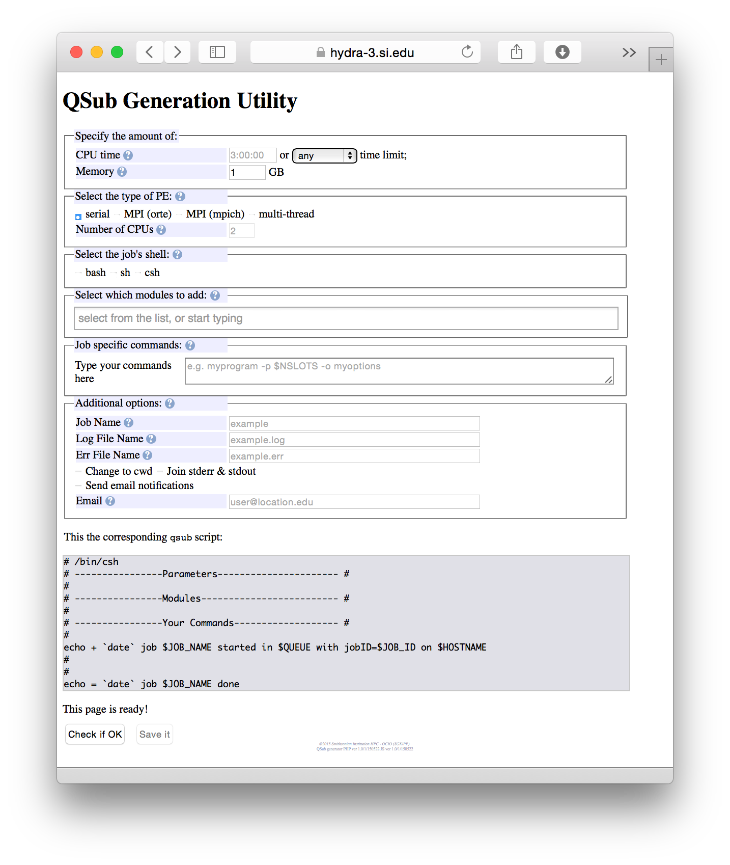
Putting it all together

Slide 29
Best Practices

Slide 30
Best use practices
Ramp up your use slowly to monitor the resources used by your jobs (CPU, memory, disk space)
Run all analyses through qsub, i.e. NO analyses other than simple scripting/moving around should be done on the login nodes.
Upload your files directly to the /pool drives, not your home directory.
Check available disk space before you upload large files.
do this with: $ df -h /pool/genomics (df=disk free)
Cleanup disk use following analysis
Remove files after transferring them back
Avoid leaving lots of small files (use tar!!)
Understand the usage requirements of the programs that you are running and use reasonable -l flags for memory and compute time.

Slide 31
Transferring files
You can use scp, sftp or rsync
Important!
Do NOT store large files on your home directory.
When given a user account, you will also be given a folder to place your files (e.g. /pool/genomics/USER).

Slide 32
Tips

Slide 33
Helpful commands
Show info for all of your running jobs: $ qstat -u $USER -s r
Display info for a specific job: $ qstat -j <job_number>
Check queue usage: $ qstat -g c
Check job stats after complete: $ qacct -j <job_number>

Slide 34
Helpful commands
Delete a job: $ qdel <job_number>
Delete all of your jobs: $ qdel -u $USER

Slide 35
Hands on

Slide 36
“Hello world”
Visit https://hydra-3.si.edu/tools/QSubGen/

Slide 38
Change to the directory that houses your qsub file: $ cd /pool/biology/<username>
Now submit your job using: $ qsub <name>.job
You can check your job status at any time by typing: $ qstat -j <job_number>
If the job has already completed, you can check how things went by typing (currently only available on head node): $ qacct -j <job_number>

Slide 39
Check to ensure that your outfile has been written: $ ls
If it is there, let’s see what it says: $ less outfile

Slide 40
There is a new alignment in /pool/biology/data called primates.dna.phy
Let’s set up a RAxML run with it.

Slide 42
This time, let’s use multiple threads
Select ‘multi-thread’ and 4 CPUs
RAxML module file is bioinformatics/raxml/8.2
Now give your RAxML command in the ‘Job specific commands’ field: raxmlHPC-SSE3-PTHREADS -T $NSLOTS -n raxmltest -s primates.dna.phy -m GTRCAT -f a -p 234532 -x 345234 -N 100
Submit this job (you should now how after doing the ‘hello world’ example.
Once your job is complete, download your output tree file.

